Slide 1

Robust outlier detection for webly-supervised image classification and action recognition
Nan Liu
06. October 2017, Garching
Supervisor: Prof. Dr. Nassir Navab
Advisors: Dr. Federico Tombari
Christian Rupprecht

Slide 2
Contents
Motivation
Approach
Evaluation
Conclusion

Slide 3
Contents
Motivation
Approach
Evaluation
Conclusion

Slide 4
Motivation
ImageNet ^{[1]}
Human-labelled dataset
Millions of images for 1000 classes
2.3% error rate for classification task in ILSVRC 2017
Webly-supervised learning
No human-labelled data is necessarily needed
Available web data is huge and continuously growing
Competitive performance to ImageNet pretrained network ^{[2]}

Slide 5
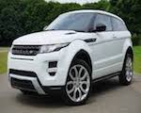
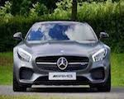
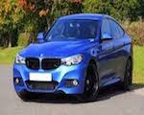
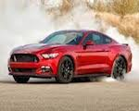
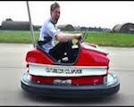
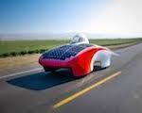

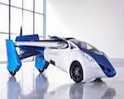
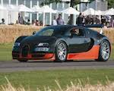
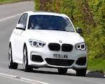
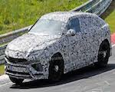

Problem
Figure 1: Images returned by search engine (google) relating to query car.

Slide 6
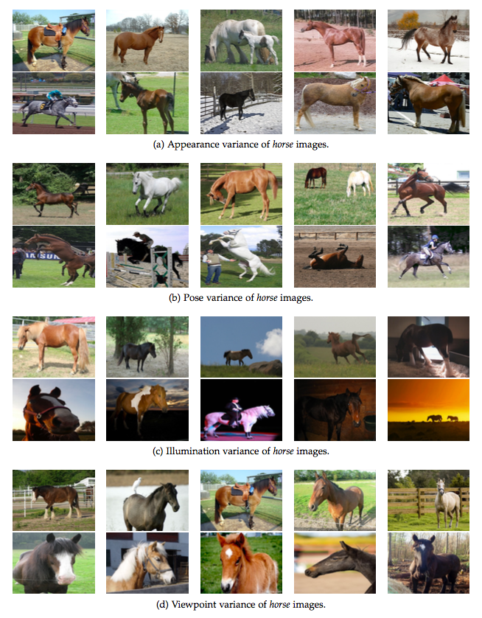
Challenges
Intra-class variance
Inter-class variance
Occlusion
Clutter
Figure 2:Illustration of intra-class variance.
Notes:
Goes to the begining

Slide 7
Contents
Motivation
Approach
Evaluation
Conclusion

Slide 8
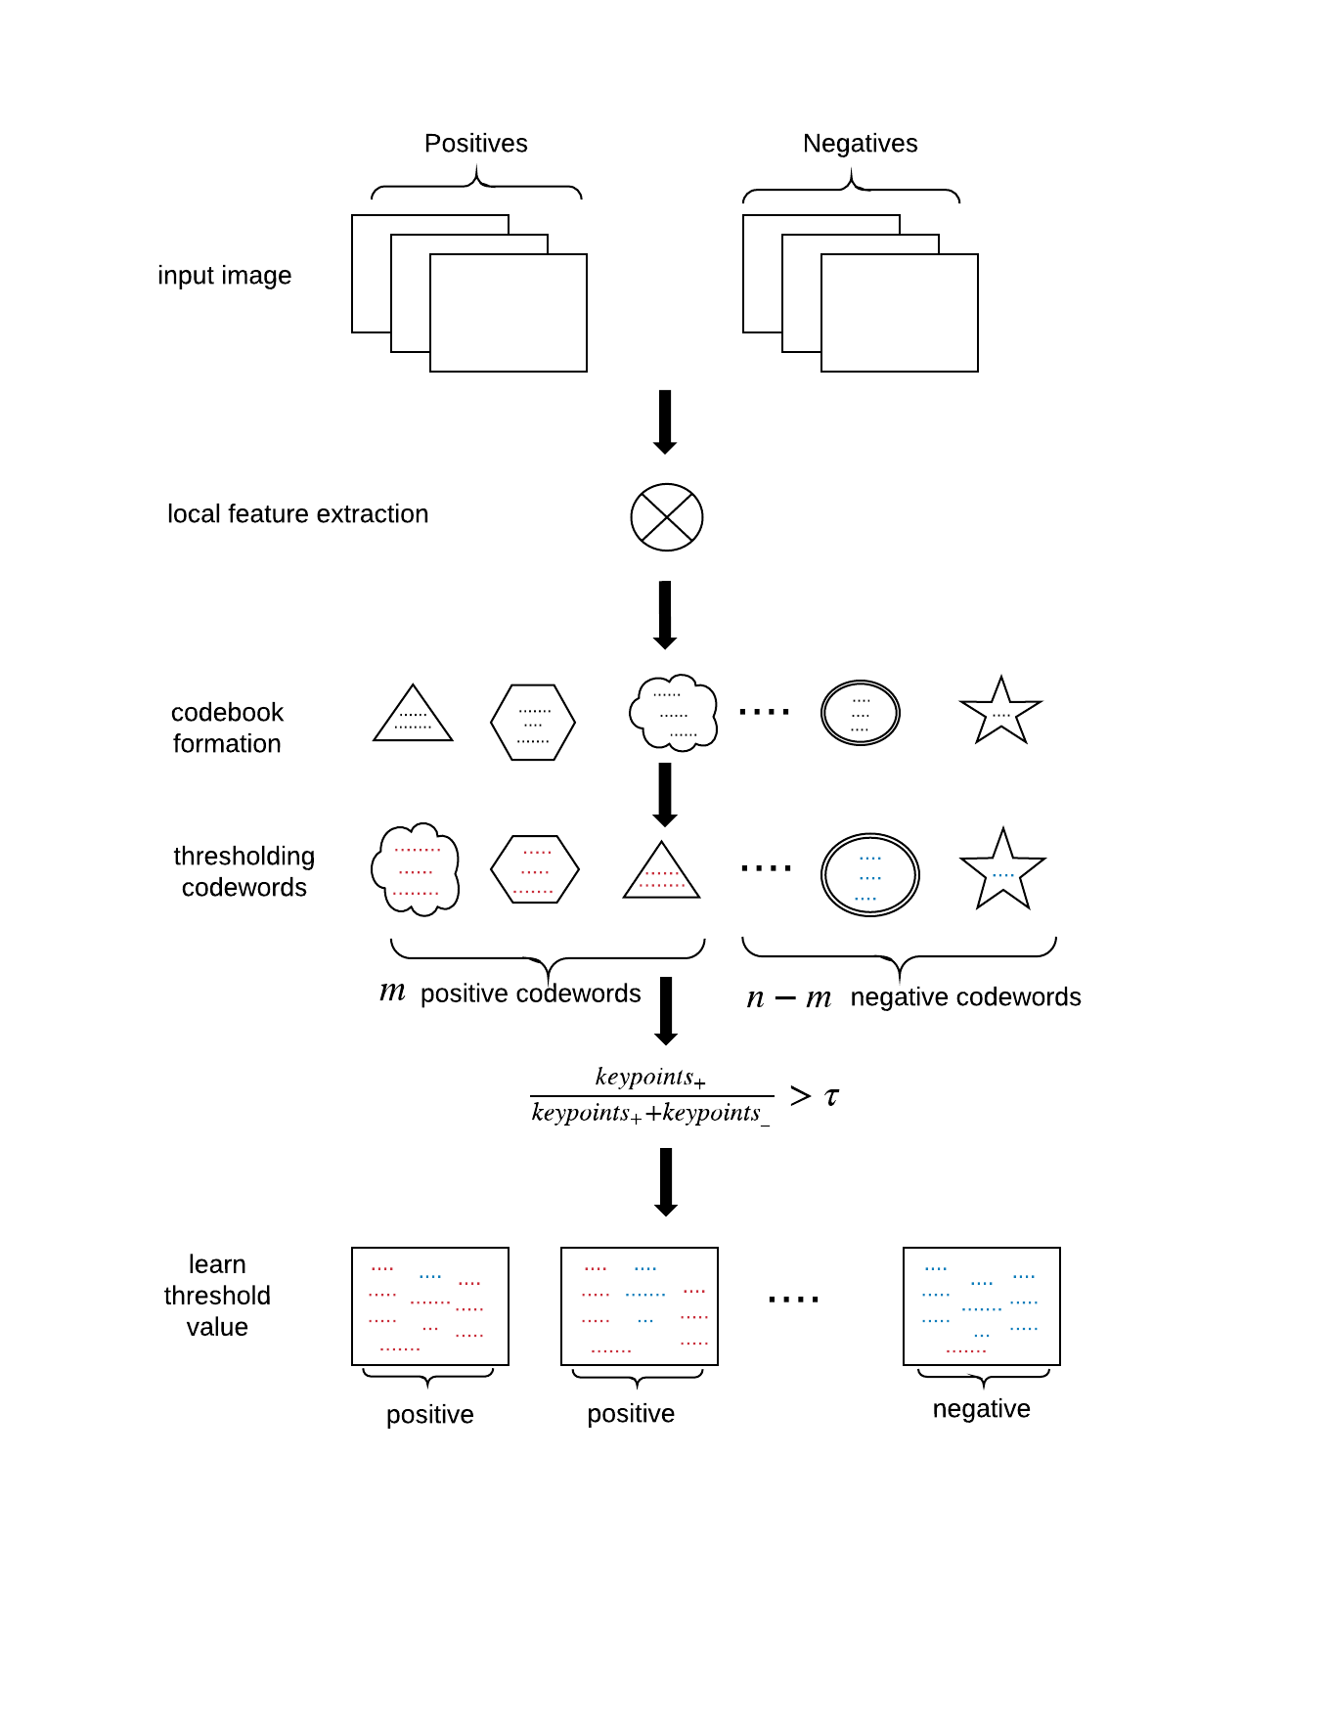
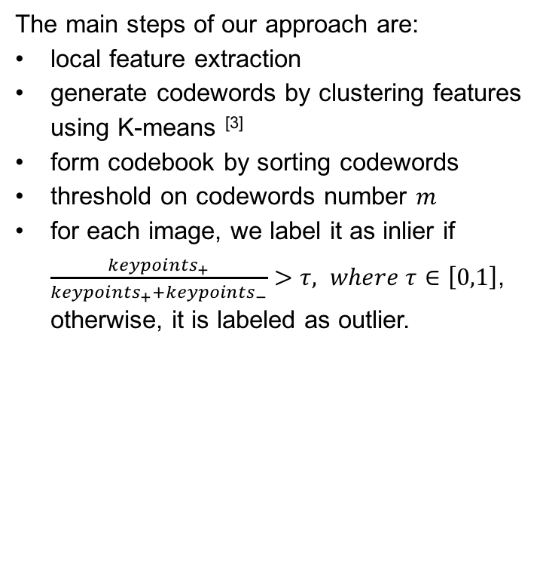
Approach
The main steps of our approach are:
local feature extraction
generate codewords by clustering features using K-means ^{[3]}
form codebook by sorting codewords
threshold on codewords number $m$
for each image, we label it as inlier if $\frac{{keypoints}_{+}}{{keypoints}_{+}+{keypoints}_{−}}>τ, where τ∈\left[0,1\right]$, otherwise, it is labeled as outlier.
Figure 3: Workflow of our approach.
[3] J. MacQueen. "Some methods for classification and analysis of multivariate observations." Proceedings of the fifth Berkeley symposium on mathematical statistics and probability. Vol. 1. No. 14. 1967.
Notes:
Intuitive explanation: Most keypoints belong to positive images, since the percentage of positive images is assumed to be much higher than the percentage of outliers
M and tau are hyperparameters.

Slide 9
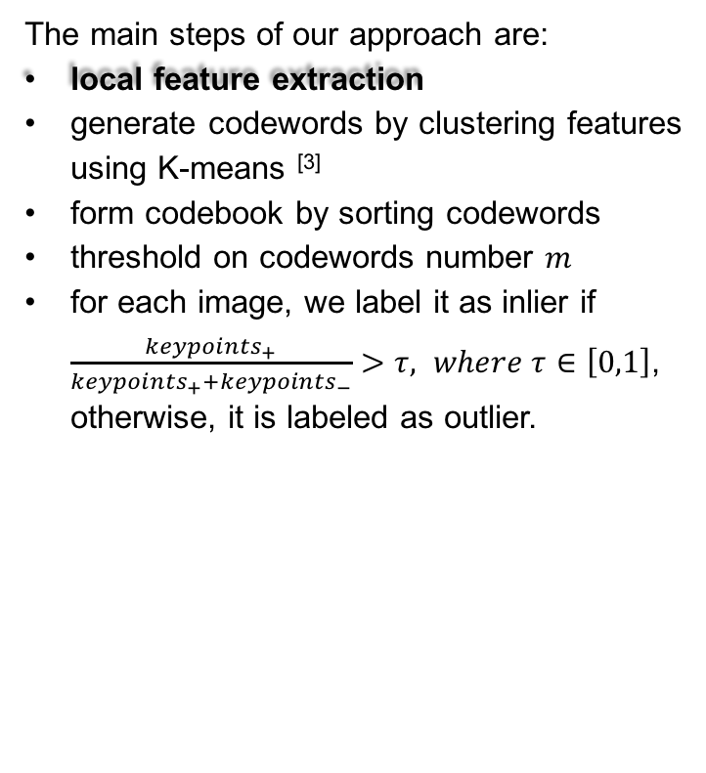
Approach
The main steps of our approach are:
local feature extraction
generate codewords by clustering features using K-means ^{[3]}
form codebook by sorting codewords
threshold on codewords number $m$
for each image, we label it as inlier if $\frac{{keypoints}_{+}}{{keypoints}_{+}+{keypoints}_{−}}>τ, where τ∈\left[0,1\right]$, otherwise, it is labeled as outlier.
Figure 3: Workflow of our approach.
[3] J. MacQueen. "Some methods for classification and analysis of multivariate observations." Proceedings of the fifth Berkeley symposium on mathematical statistics and probability. Vol. 1. No. 14. 1967.

Slide 10
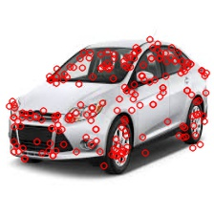
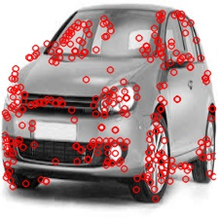
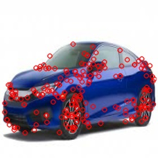
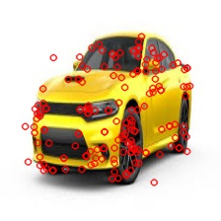
Local feature extraction
Statistical feature
Color histogram
HOG
SIFT
Deep-learned feature
Global feature representation
Figure 4: An example of SIFT features.

Slide 11
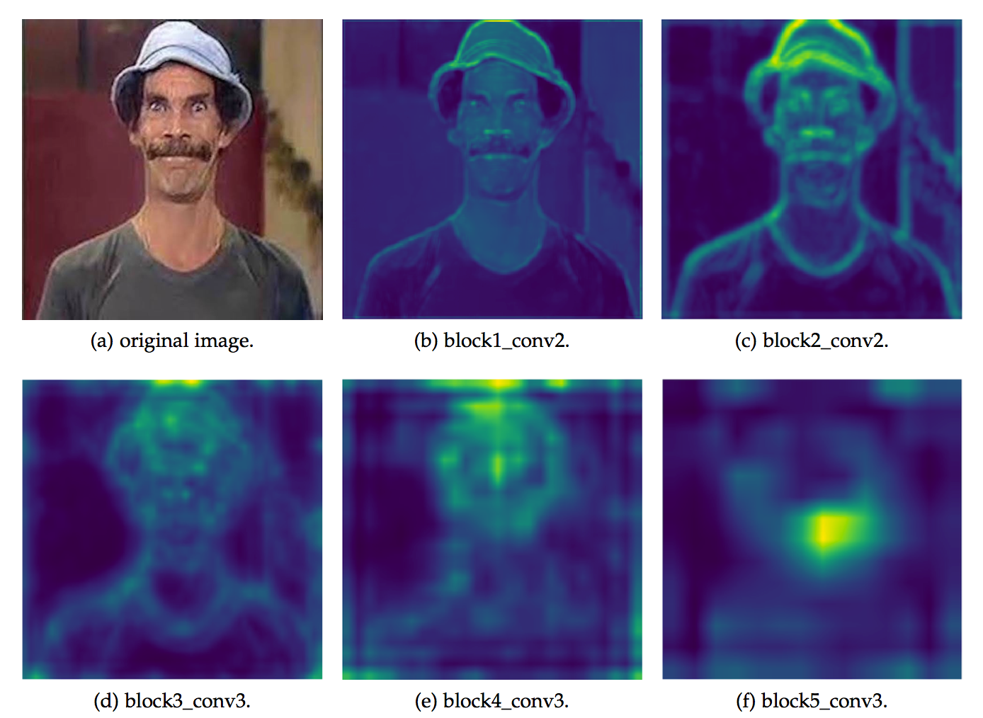
Local feature extraction
Figure 5: Feature maps of image madruga from different layers of VGG-16.

Slide 12
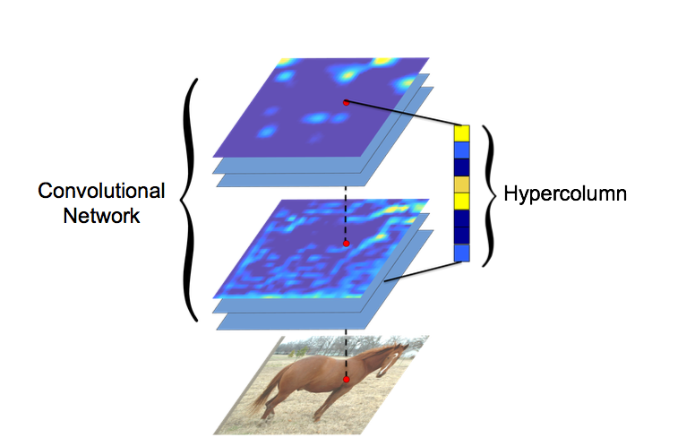
Local feature extraction
Statistical feature
Color histogram
HOG
SIFT
Deep-learned feature
Global feature representation (Image Clustering)
Local feature representation: Hypercolumn ^{[5]}
Figure 6: Illustration of Hypercolumn (from [5]).
[[5] B. Hariharan, P. Arbeláez, R. Girshick, and J. Malik. "Hypercolumns for object segmentation and fine-grained localization." Proceedings of the IEEE Conference on Computer Vision and Pattern Recognition. 2015.

Slide 13
Contents
Motivation
Approach
Evaluation
Conclusion

Slide 14

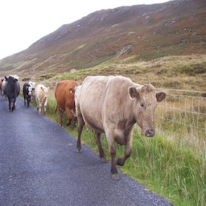
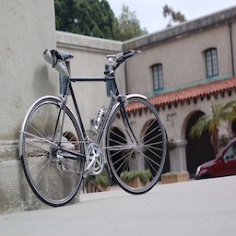
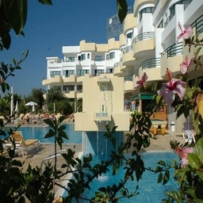
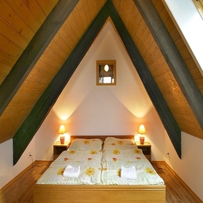
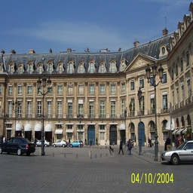
Evaluation
Datasets
Synthetic
Pascal VOC 2012 ^{[6]}
MITPlaces ^{[7]}
Baseline methods
Random Walk ^{[8]}
Exemplar-LDA ^{[9]}
Figure 7: Example images from Pascal and MITPlaces.
[6] M. Everingham, L. Van Gool, C. K. I. Williams, J. Winn & A. Zisserman. "The pascal visual object classes challenge 2012 (voc2012) results (2012)." URL http://www. pascal-network. org/challenges/VOC/voc2011/workshop/index. html. 2011.
[7] B. Zhou, A. Lapedriza, L. Xiao, A. Torralba, and A. Oliva. "Learning deep features for scene recognition using places database." Advances in neural information processing systems. 2014.
[8] H. D. K. Moonesignhe and P. Tan. "Outlier detection using random walks." Tools with Artificial Intelligence, 2006. ICTAI'06. 18th IEEE International Conference on. IEEE, 2006.
[9] B. Hariharan, M. Jitendra and R. Deva. "Discriminative decorrelation for clustering and classification." Computer Vision–ECCV 2012 (2012): 459-472.

Slide 15
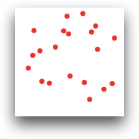
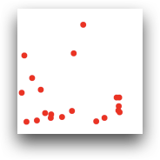
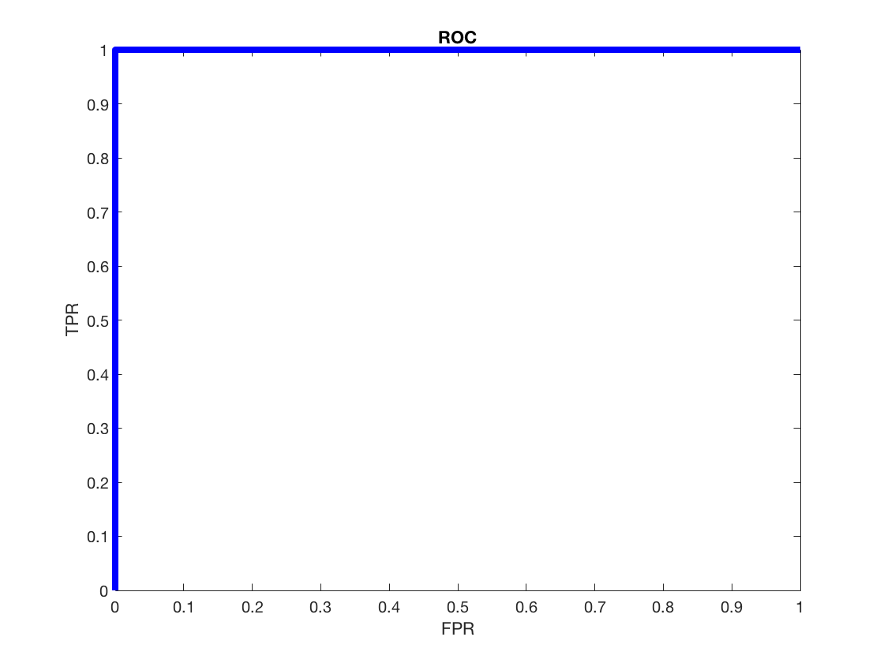
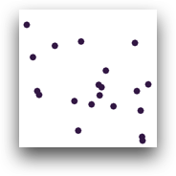
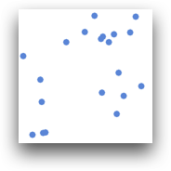
Evaluation on dataset Synthetic_v1
inliers (90)
…
outliers (10)
…
Figure 8: Performance of our approach (right) on Synthetic_v1 (left) with color histogram feature representation.

Slide 16


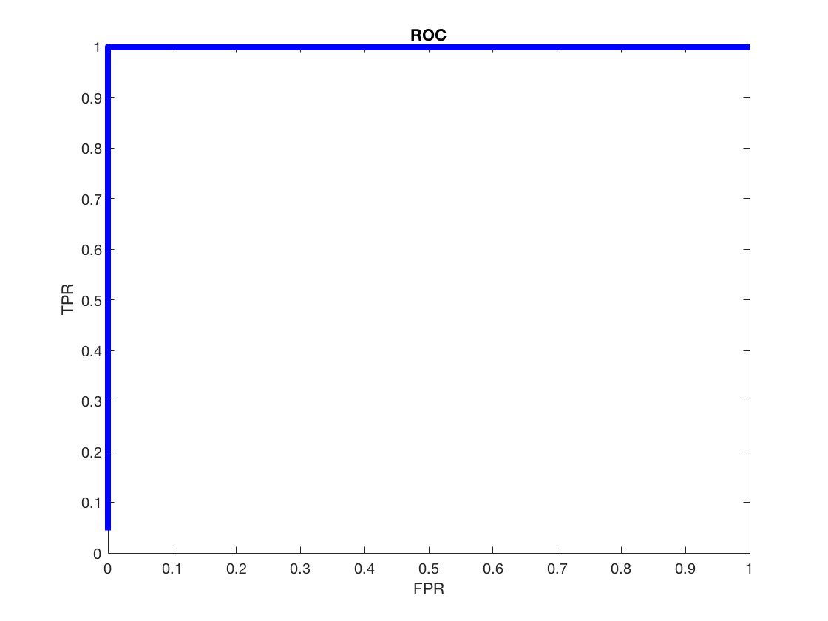
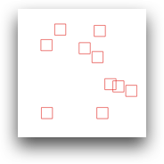
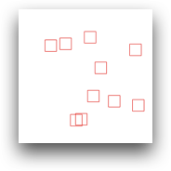
Evaluation on dataset Synthetic_v2
inliers (90)
…
outliers (10)
…
Figure 9: Performance of our approach (left) on Synthetic_v2 (right) with HOG feature representation.

Slide 17
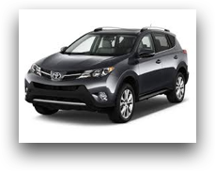
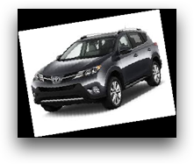
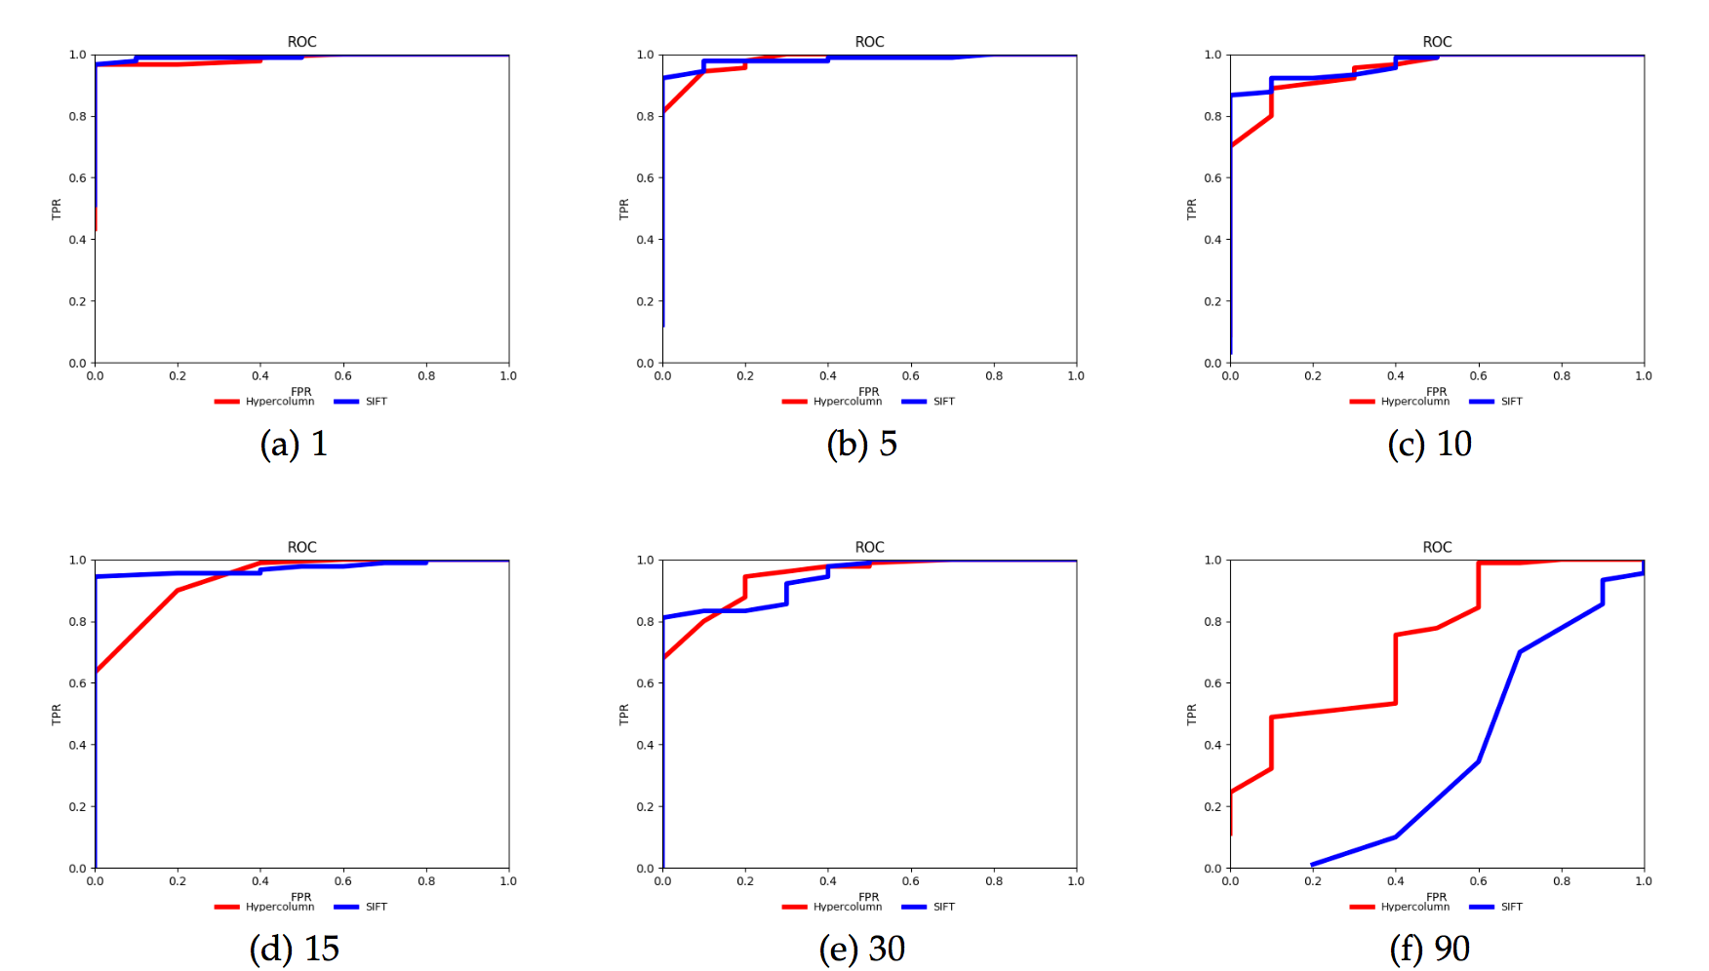
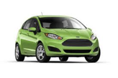
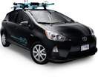
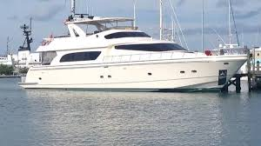
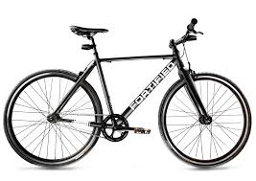
Evaluation on dataset Synthetic_v3
inliers (90)
…
outliers (10)
…
Figure 10: Performance of our approach (right) on dataset Synthetic_v3 (left) with SIFT and Hypercolumn feature representation.

Slide 18
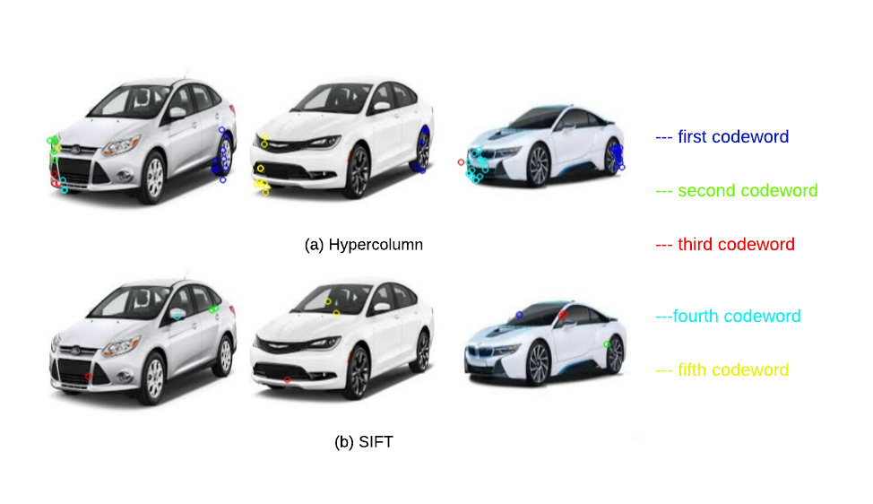
Difference between Hypercolumn and SIFT
Figure 11: Visualization of first five codewords of (a) Hypercolumn and (b) SIFT based feature representation.
Notes:
SIFT to detect keypoints, same number of keypoints, set same number of cluter number K, but different representations
SIFT focused on the local corner features, and Hypercolumns get the semantic meaning of the images.

Slide 19
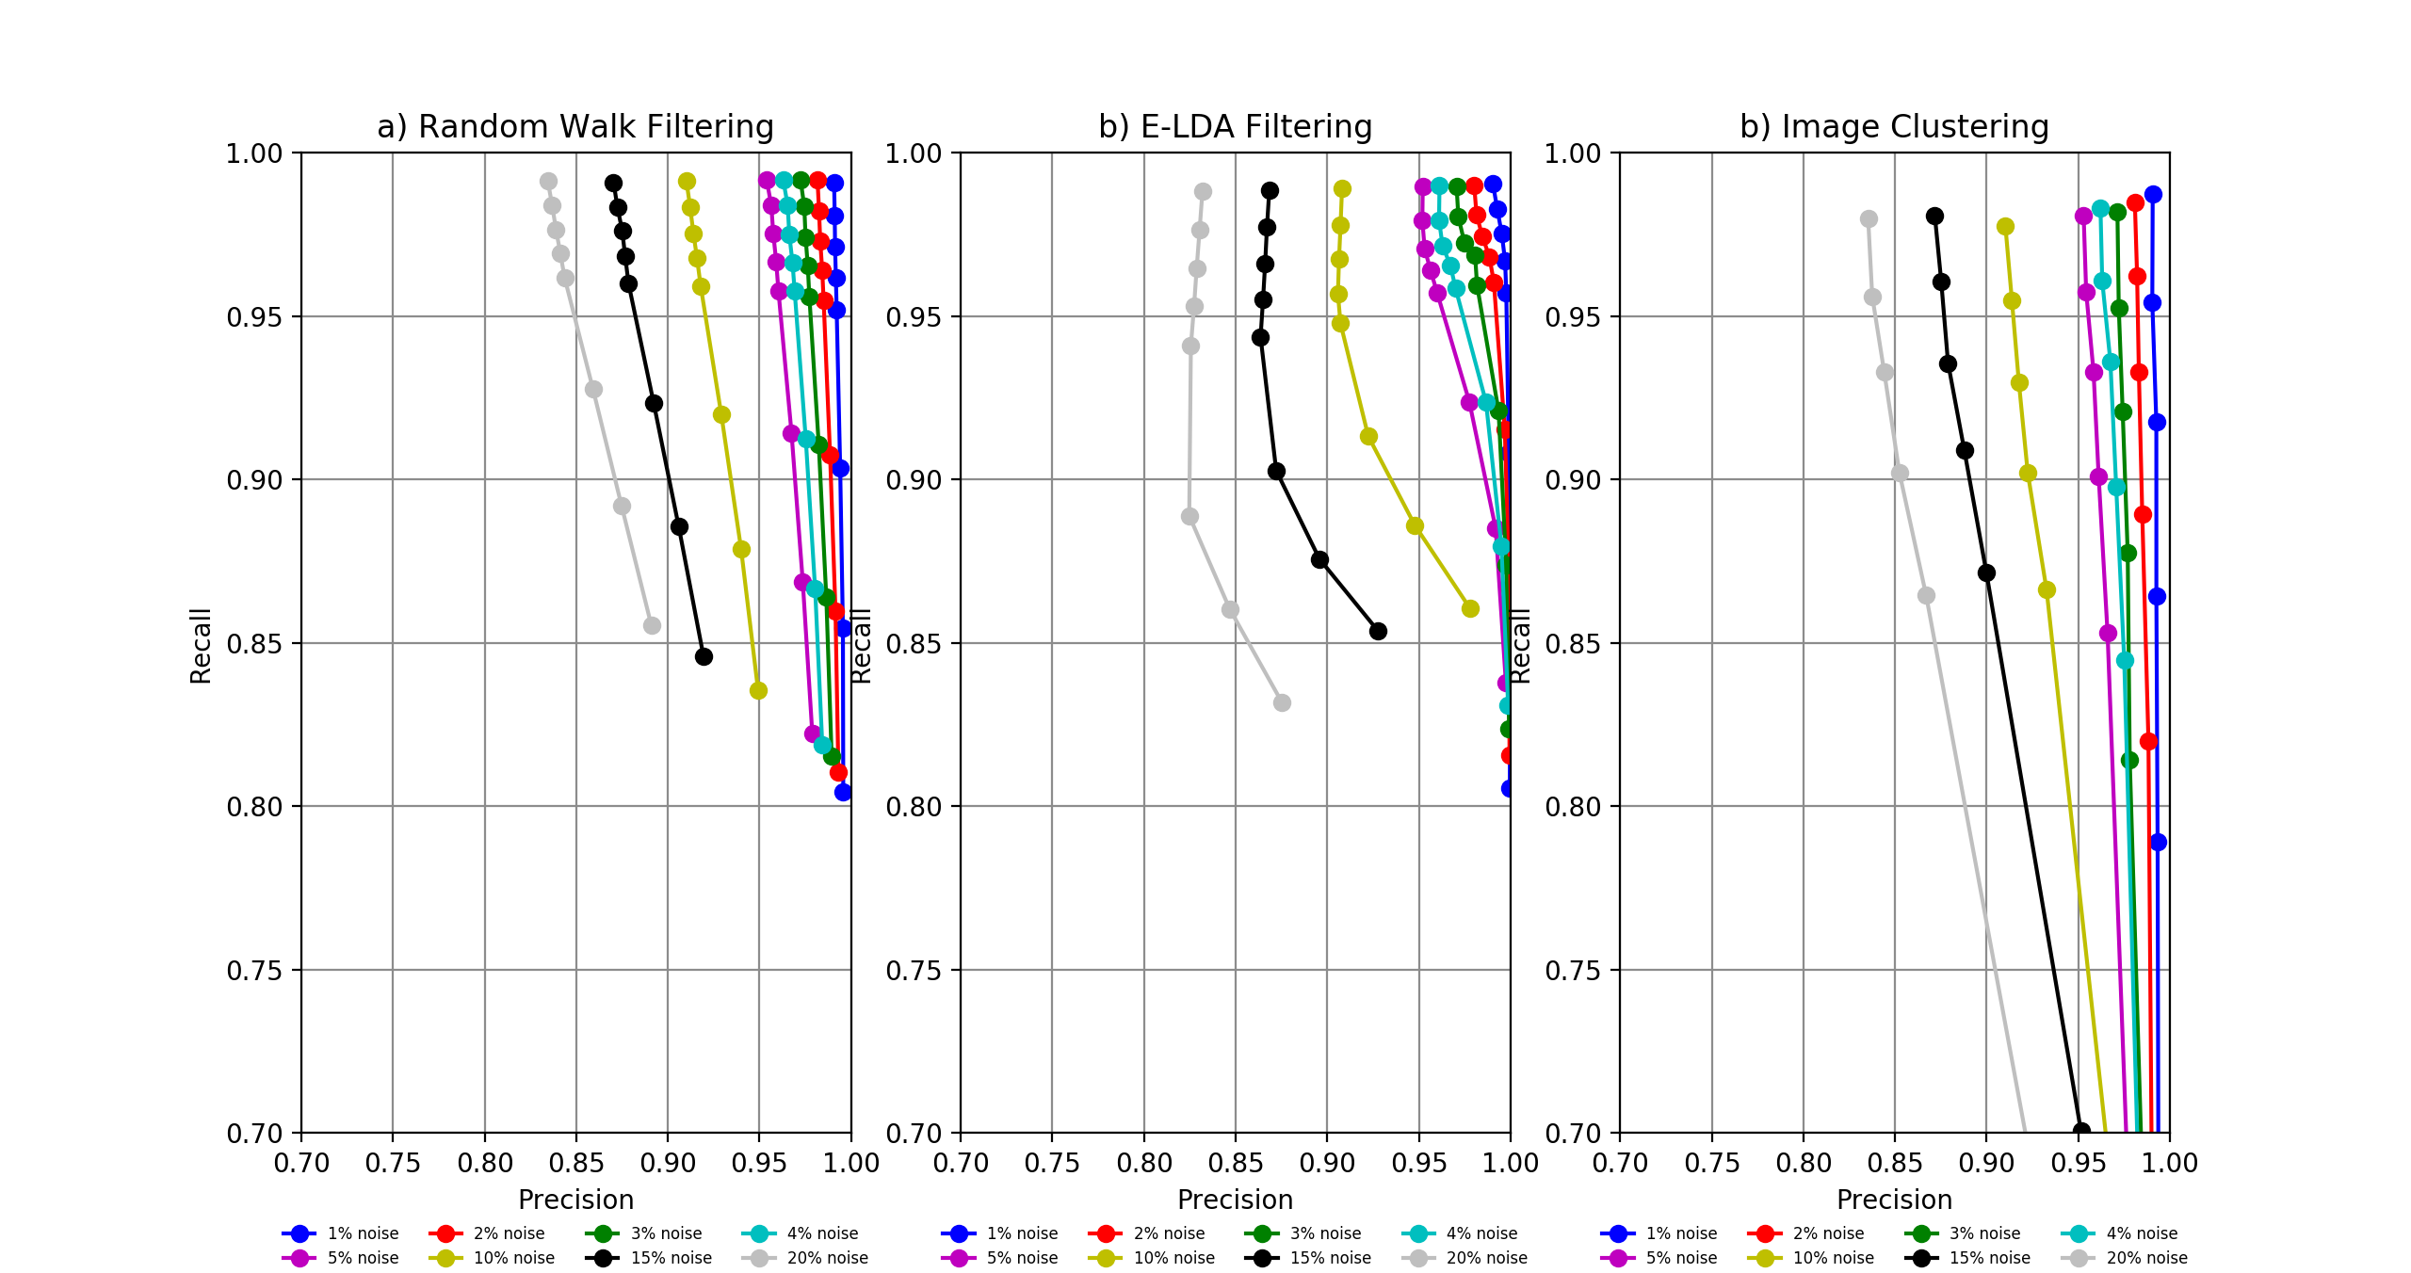
Baseline methods
Figure 12: Performance of a) Random Walk, b) E-LDA and c) Image Clustering on dataset Pascal.

Slide 20
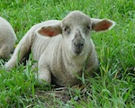
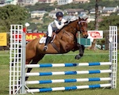

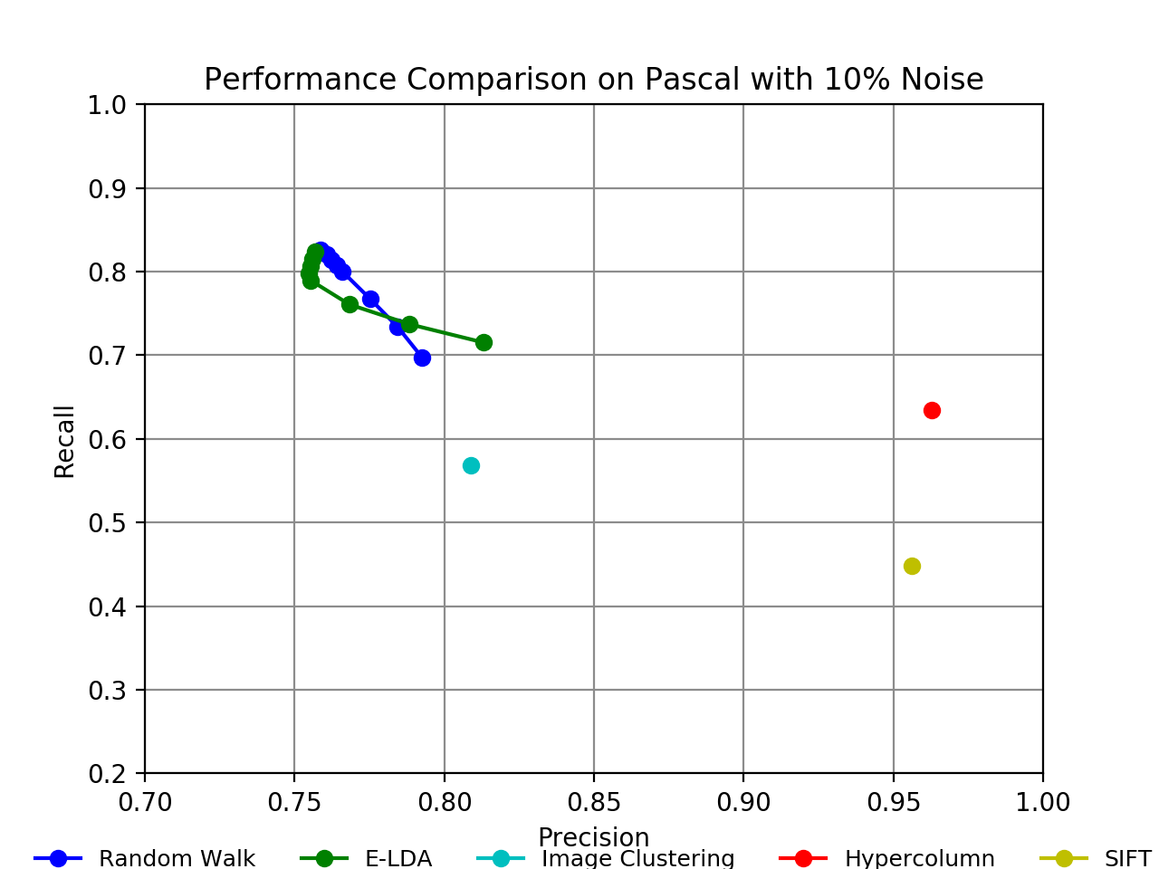


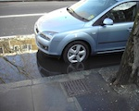
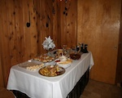
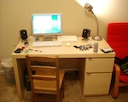

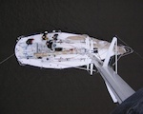
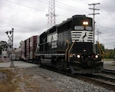

Evaluation on dataset Pascal
Figure 13: Performance comparison of Random Walk, Exemplar-LDA, Image Clustering, SIFT and Hypercolumn based methods (right) on dataset Pascal (left).
Notes:
To save time, we only test on datasets at 10% noise level.

Slide 21













Evaluation on dataset MITPlaces
Figure 14: Performance comparison of Random Walk, Image Clustering, SIFT and Hypercolumn based methods (right) on dataset MITPlaces (left).
Notes:
Mention the outlier classes

Slide 22






































Figure 15: An example of selected inliers and rejected outliers (marked with red box) detected by our approach.

Slide 23
Contents
Motivation
Approach
Evaluation
Conclusion

Slide 24
Conclusion
Robust outlier detection method
Unsupervised
No prior knowledge required of the data
Few hyperparameters
Hypercolumn representation performs better than SIFT representation
When noisy images are diversified, local feature representation outperforms global feature representation

Slide 25
Thank you!

